Slide 1
Transistors, Operations and it’s basic Structure
Ayesha Hassan
Eylaf Khalil Ahmed

Slide 2
Agenda:
Introduction of Transistors
Importance of Transistors
Types of Transistors
Basic Structure of Transistors
Operations of Transistors
Applications of Transistors
Advantages and Disadvantages of Transistors
Conclusion

Slide 3
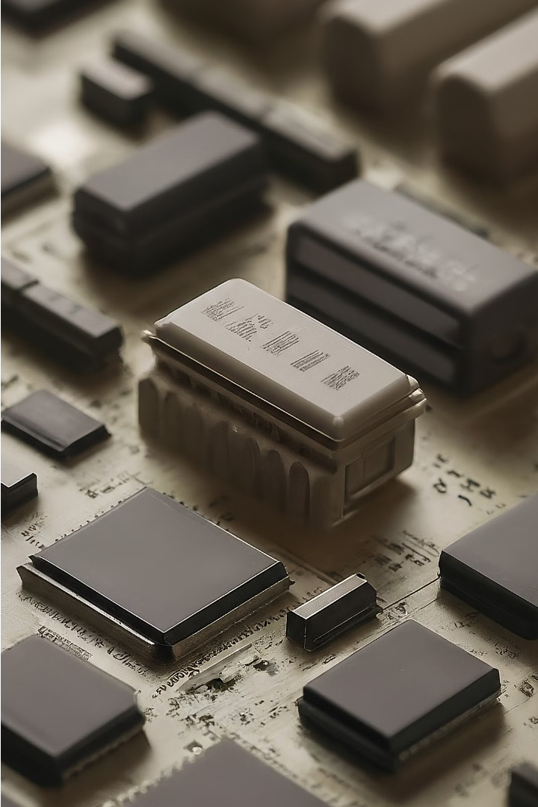
Introduction to Transistors
Transistors are semiconductor device.
It act as amplifier or switch.
It play a fundamental role in modern electronics.
They are the building blocks of integrated circuits, enabling the design of complex electronic systems that power our digital world.

Slide 4
Importance of Transistors
Flexibility
Power Efficiency
Transistors can function as amplifiers, switches, and logic gates, making them essential for a wide range of electronic applications.
The small size and low power consumption of transistors have enabled the development of energy-efficient electronic devices.

Slide 5
Types of Transistors
BJTs and FETs are types of transistors:
BJTs (Bipolar Junction Transistor)
Use both electrons and holes.
NPN: Electrons flow from emitter to collector with base current.
PNP: Holes flow from emitter to collector with base current.
FETs ( Field Effect Transistor)
Control current using an electric field.
There are two types of FETS
MOSFET (Metal Oxide Semiconductor Field Effect Transistor) : Uses gate voltage to control conductivity.
JFET(Junction Field Effect Transistor): Controls current flow along the channel with a semiconductor junction.

Slide 6
Basic Structure of a Transistor
Imagine a transistor like a sandwich made of three layers of semiconductor material: the Emitter, Base, and Collector.
Emitter
Base
Collector
layer is like the top slice of bread, heavily packed with impurities and extra electrons
layer is like the filling in the middle, lightly doped, and controls the flow of electrons between the Emitter and Collector.
layer is like the bottom slice of bread, also doped with impurities but not as much as the Emitter. It collects the majority of electrons from the Emitter.

Slide 7
Operations of Transistors
Transistors are like tiny switches for electricity. They have three parts:
Emitter: Where electricity starts.
Base: Controls electricity.
Collector: Where electricity ends.
Bipolar Junction Transistor (BJT): Works like a faucet, controlling electricity. Two types: NPN and PNP, for different charges.
Field Effect Transistor (FET): Acts as a gate: voltage opens or closes it, letting electricity flow. MOSFETs have a metal gate and insulating layer; JFETs use a semiconductor gate.
Transistors are super important for controlling electricity in devices like amplifiers, computers, smartphones, and TVs. Without them, our gadgets wouldn't work as well

Slide 8
Applications of Transistors
Computing Devices:
Mobile Phones:
Transistors in computers, including CPUs, GPUs, and memory chips, act as tiny switches controlling electrical signals, crucial for executing tasks like data processing and user interactions.
Modern smartphones contain millions to billions of transistors integrated into their processors, enabling efficient processing of tasks from calls to high-definition video streaming.
Audio Amplifiers:
Transistors amplify audio signals in devices like home audio systems and headphones, enhancing weak signals for clearer and louder playback.

Slide 9
Advantages and Disadvantages of Transistors
Advantages
Disadvantages
Small size and low power consumption
easily damaged if it gets too hot or if there's too much electricity flowing through it.
Reliable and durable performance
Transistors amplify signals, making them stronger and more usable in electronic devices.
it's complicated and needs special knowledge and tools to do it right.

Slide 10
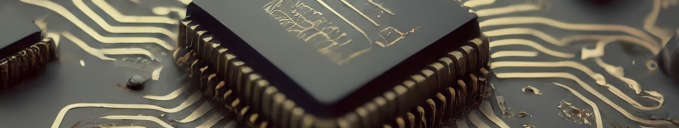
Conclusion
Transistors are like the superheroes of electronics. They're everywhere and do amazing things! Understanding how they're built and how they work is super important for designing all the cool gadgets we use every day. Let's keep embracing the power of transistors and see where they take us in the future!

